Slide 2
Lessons learned 2024

Slide 3

Lessons learned 2024
Small Steps,

Slide 4
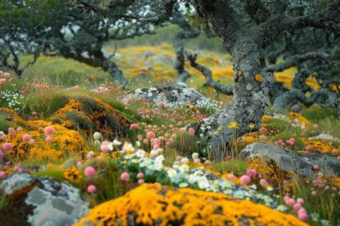
Lessons learned 2024
Small Steps, Big Impact

Slide 5
Communities
WHY?

Slide 6
Human connection.

Slide 7
Not feeling alone in your passion or cause.

Slide 8
GSF NL Community Online?

Slide 9
Existing Sustainability Communities Need You!

Slide 10
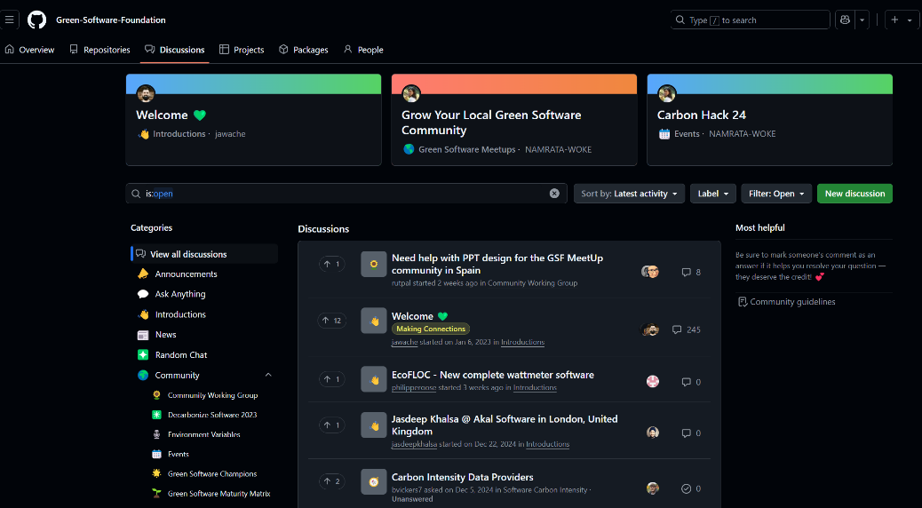
https://github.com/orgs/Green-Software-Foundation/discussions

Slide 11
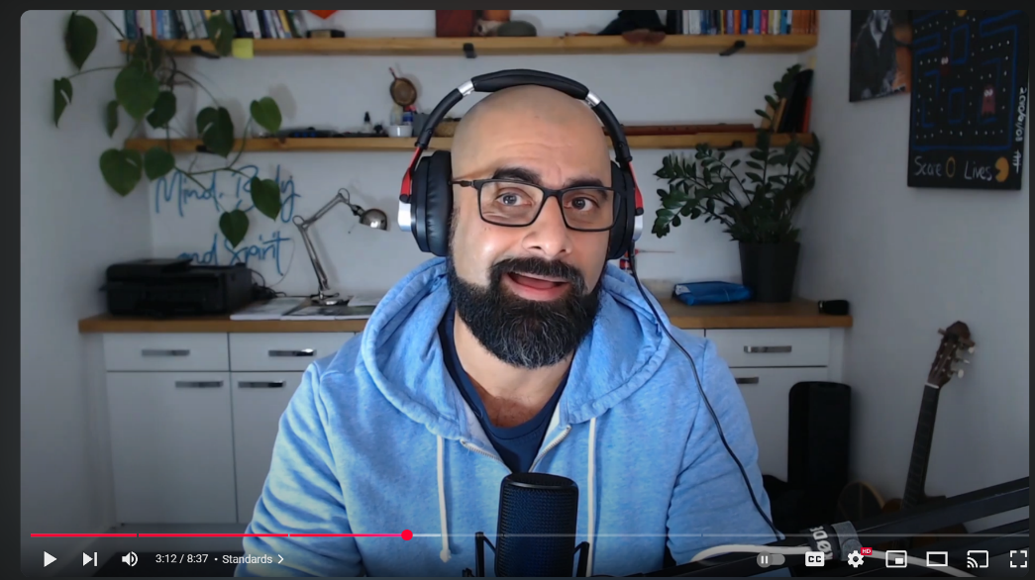
https://www.youtube.com/watch?v=x8fSSCyxIrU
Asim Hussain I 2024 I Recap

Slide 12
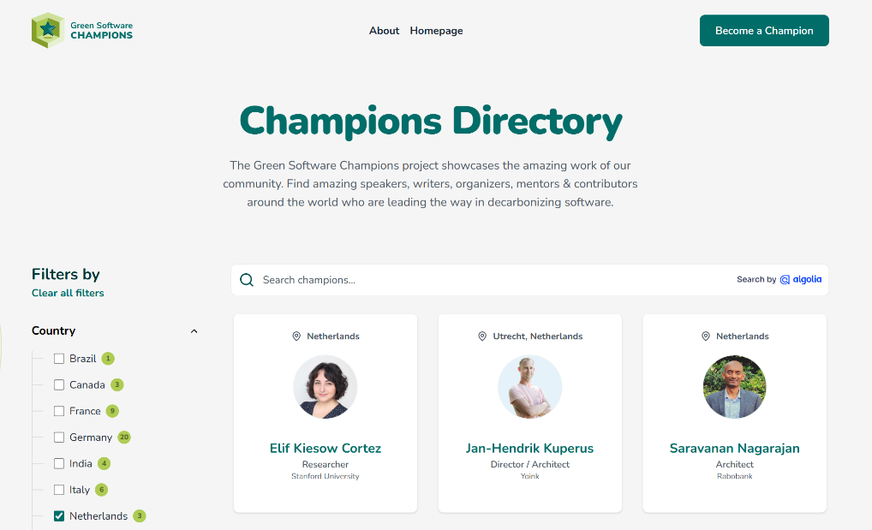
https://champions.greensoftware.foundation/
Asim Hussain I 2024 I Recap

Slide 13
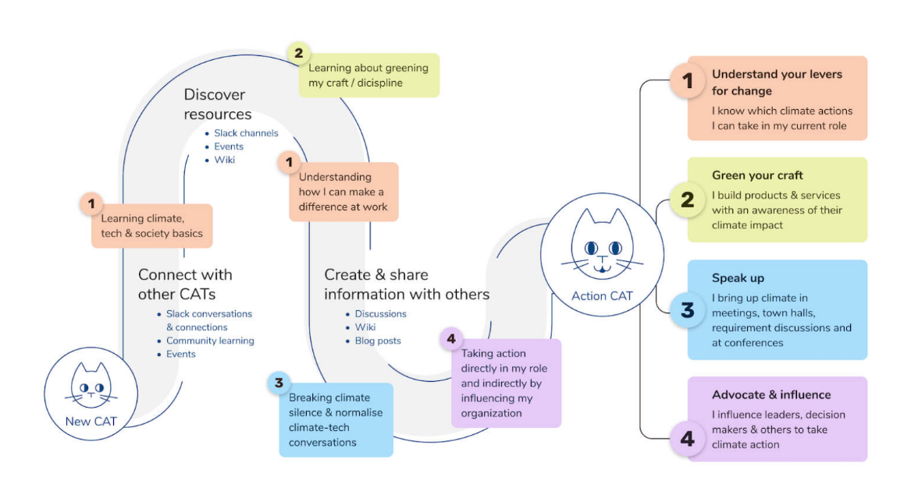
https://climateaction.tech/community/

Slide 14
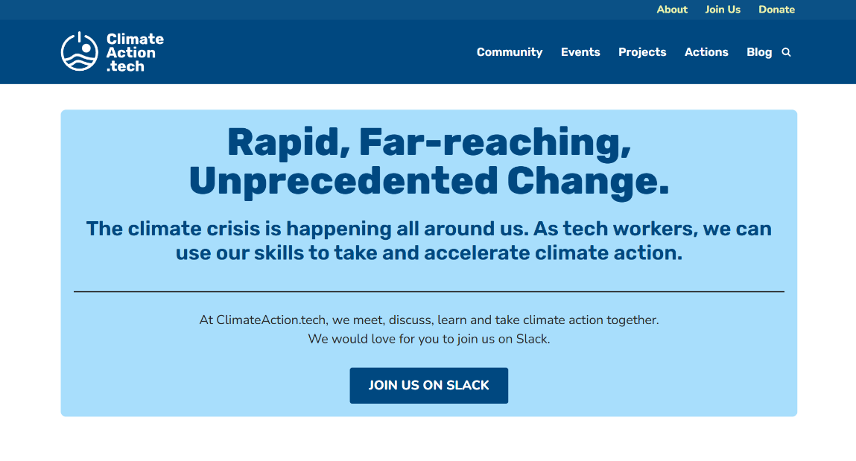
https://climateaction.tech/community/

Slide 15
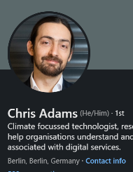
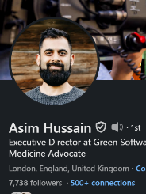
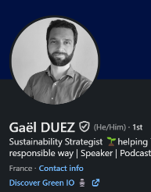
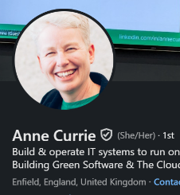
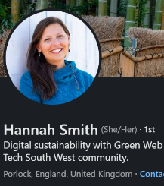
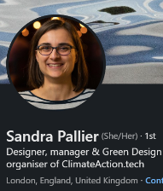
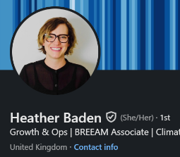
https://climateaction.tech/community/

Slide 16
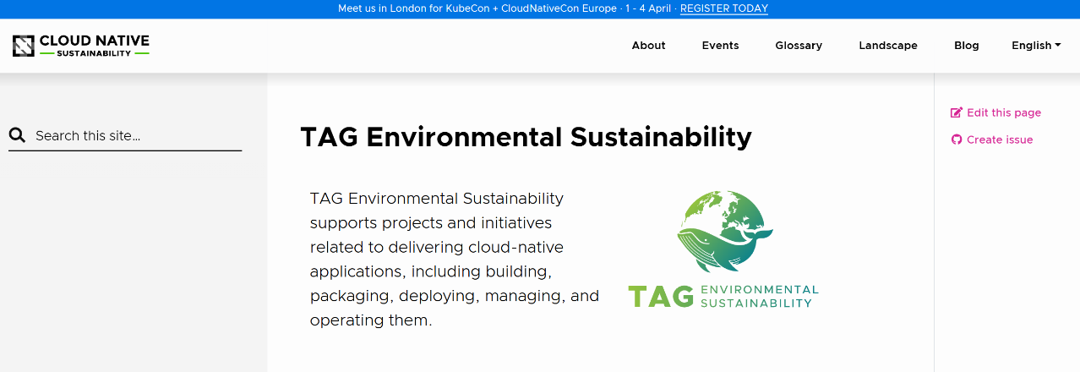
https://tag-env-sustainability.cncf.io/

Slide 17
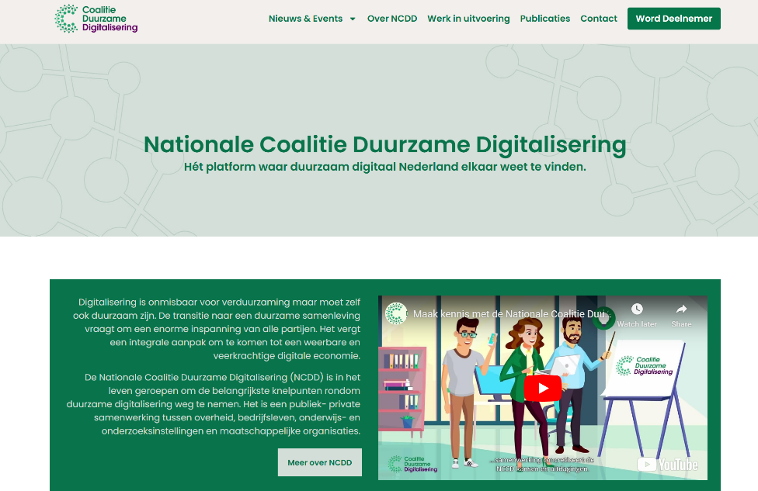
https://coalitieduurzamedigitalisering.nl/

Slide 18
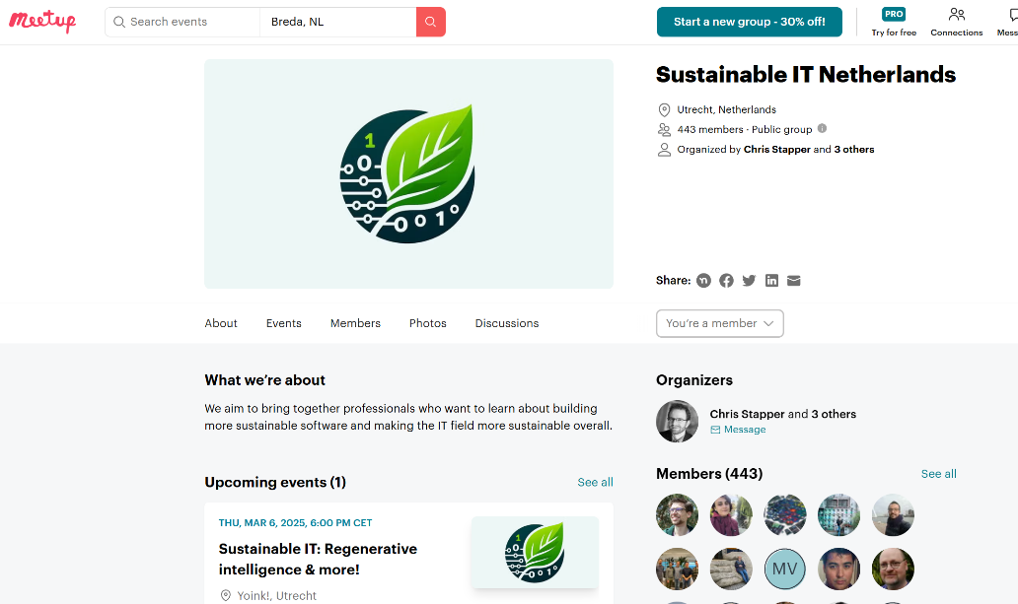
https://www.meetup.com/sustainable-it-netherlands/?eventOrigin=your_groups

Slide 19
https://greenio.tech/conferences
Sustainability Engineer – Focuses on optimizing IT infrastructure for environmental impact reduction.
Green Software Developer – Develops energy-efficient and sustainable software applications.
Cloud Sustainability Architect – Designs and optimizes cloud infrastructure with a focus on reducing carbon footprint.
AI Ethics & Sustainability Specialist – Ensures AI solutions are designed with minimal environmental impact.
IT Decarbonization Consultant – Helps organizations reduce the carbon footprint of their IT systems.
Digital Sustainability Analyst – Measures and tracks the environmental impact of digital products and services.
Eco-design UX/UI Designer – Designs digital products with energy efficiency and sustainability in mind.
Sustainable DevOps Engineer – Implements green DevOps practices to optimize infrastructure and resource usage.
Responsible Data Scientist – Develops AI/ML models with a focus on energy efficiency and sustainability.
IT Governance & Compliance Manager (Sustainability Focus) – Ensures IT sustainability aligns with corporate and regulatory standards.

Slide 20
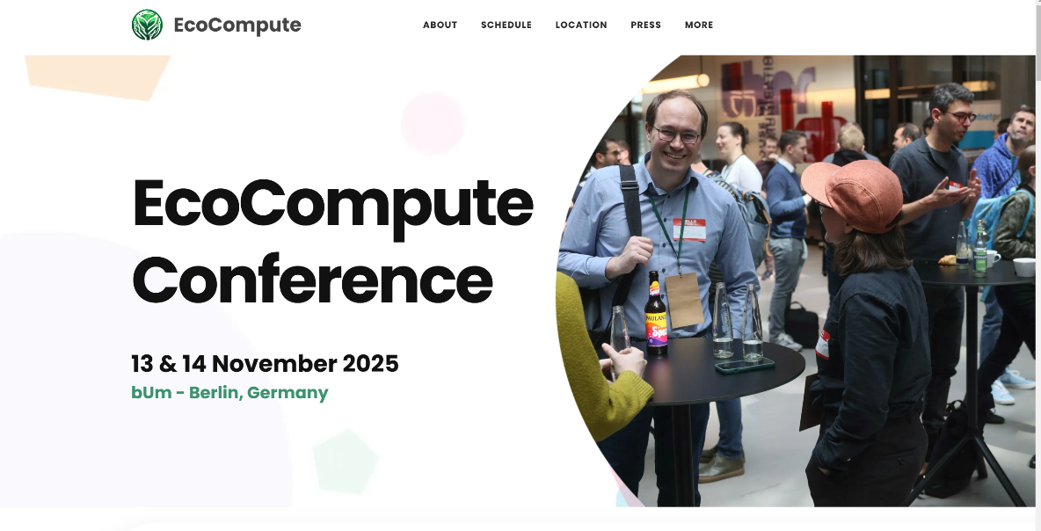
https://www.eco-compute.io/

Slide 21
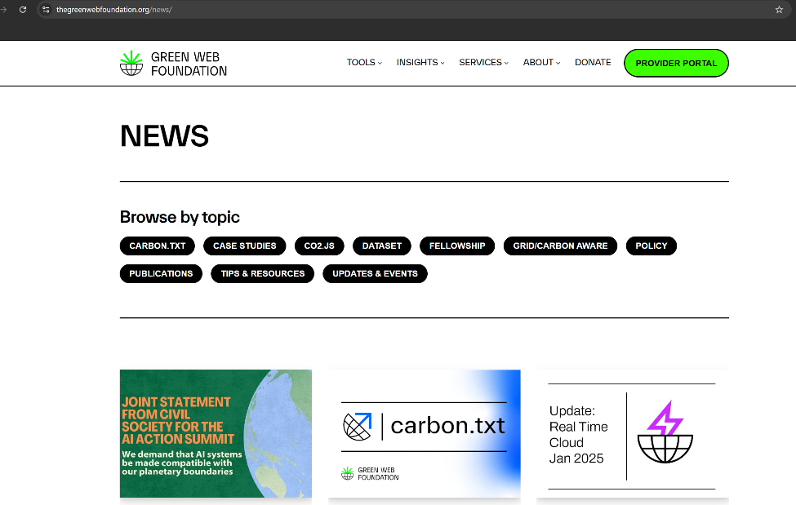
https://www.thegreenwebfoundation.org/news/

Slide 22
We Need You!

Slide 23
Don’t overcomplicate. K.I.S.S.

Slide 24
HI!

Slide 25
Help organize meetups in NL and EU

Slide 26
Create content on Wikis and Forums. Based on what you know.

Slide 27
Just talk to people in the community to feel home and connected.

Slide 28
Help building tools.

Slide 29
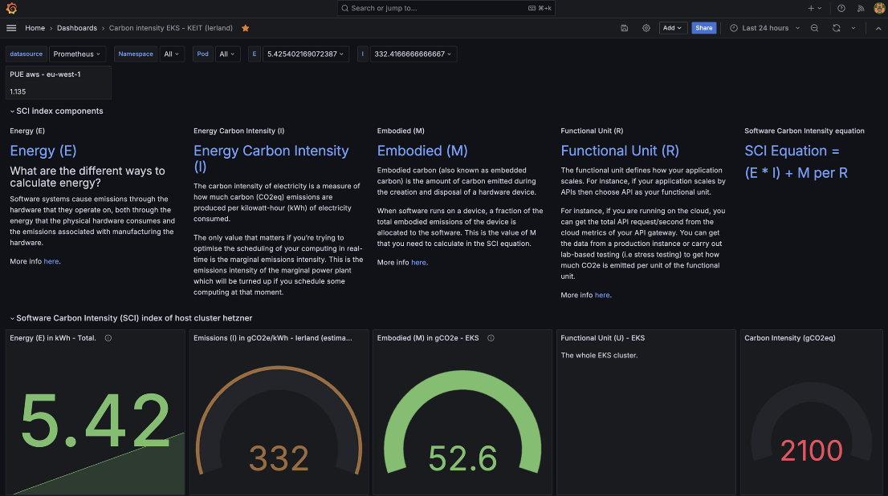
https://aknostic.com/keit/

Slide 30
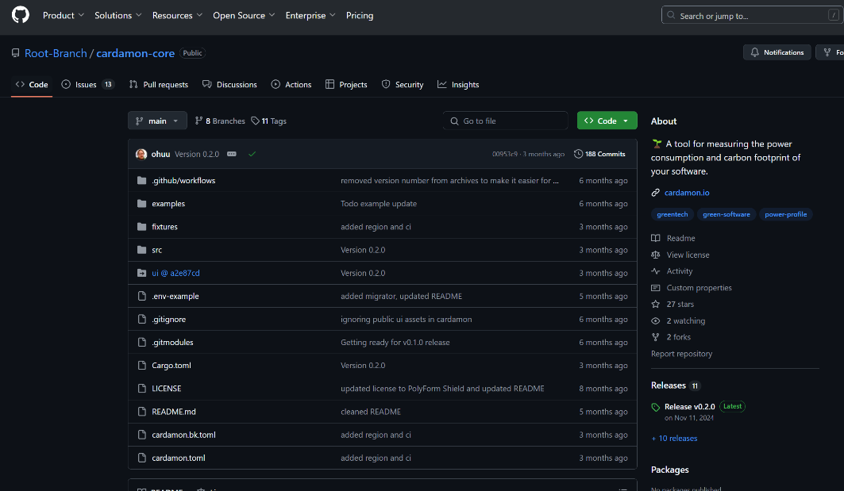
https://github.com/Root-Branch/cardamon-core

Slide 31
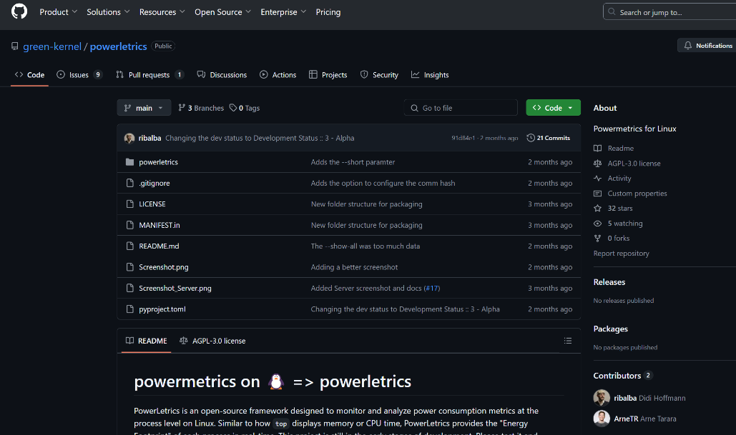
https://github.com/green-kernel/powerletrics

Slide 32
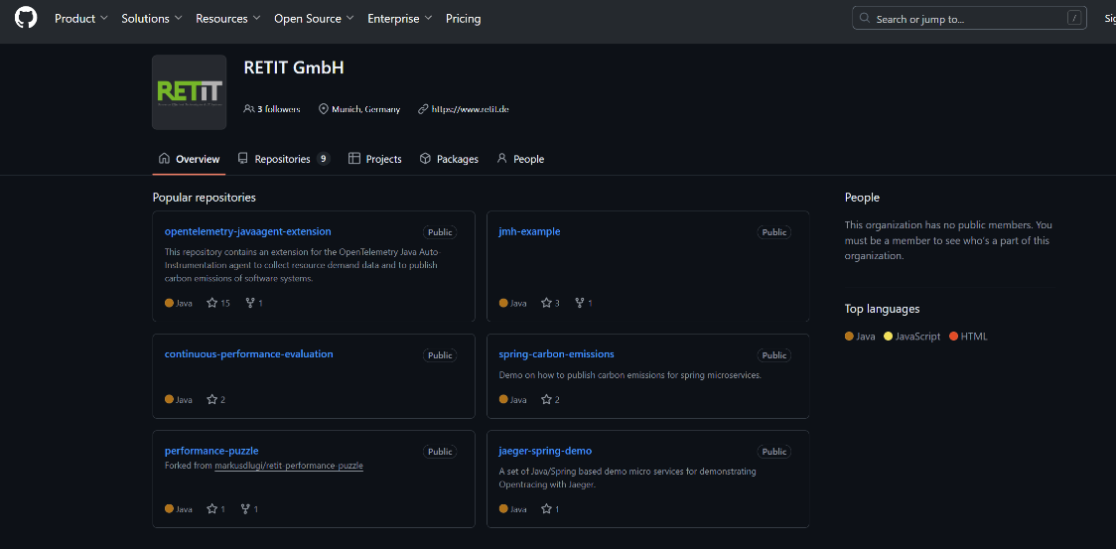
https://github.com/RETIT

Slide 33
Etc.

Slide 34
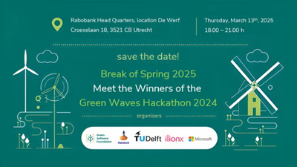

Slide 35
Maarten is a great example of this all.

Slide 36
Questions?

